Slide 1
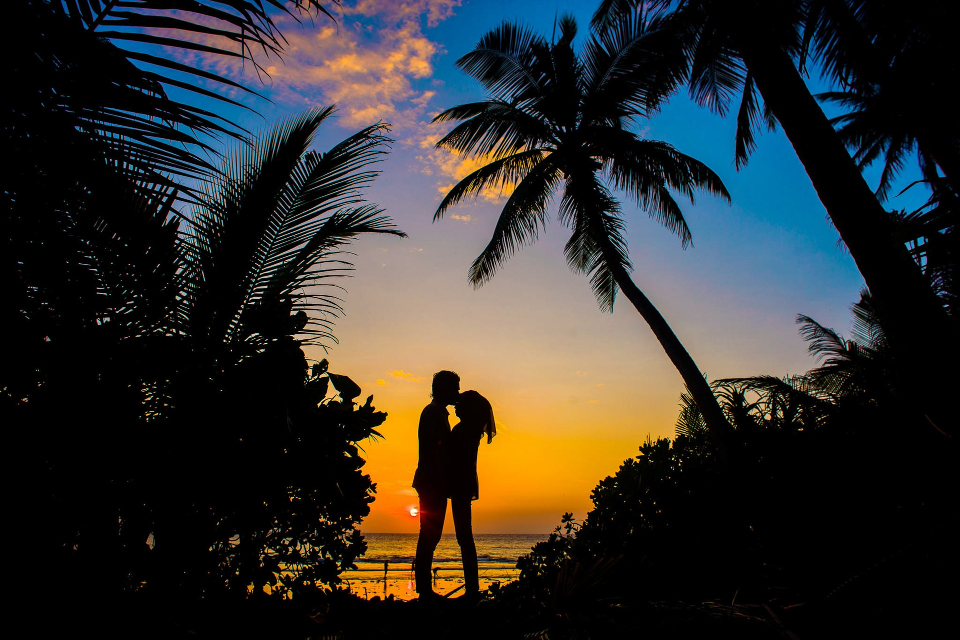
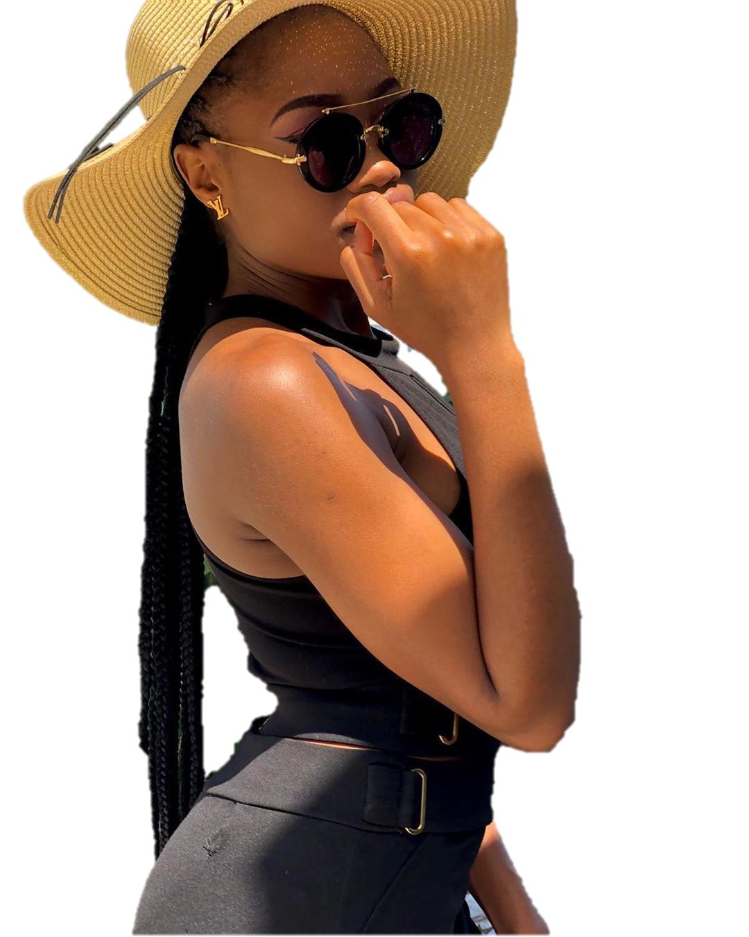
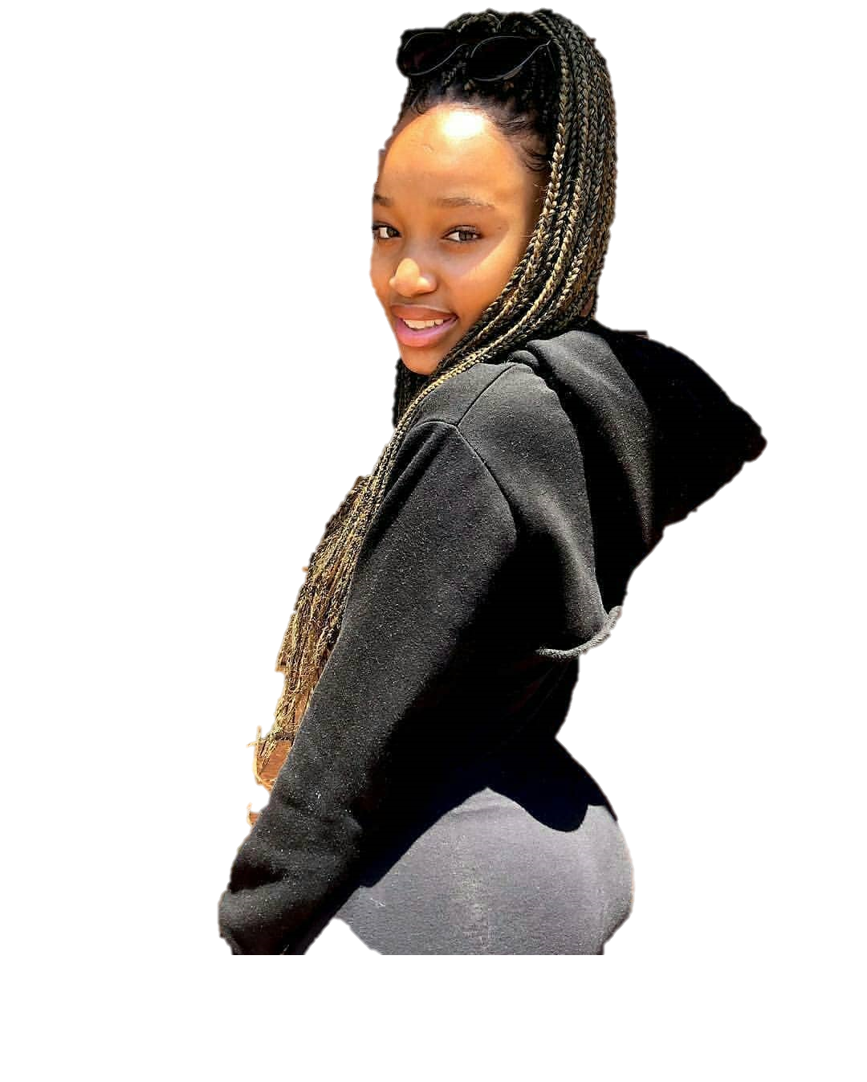

Bigbuddies presents
24
DEC
GET TOGETHER
Summer time
DJ VXrTYM & DJ ORYX2R
Start 10PM-04AM dress to impress
DUSHBACK NIGHT CLUB
Ladies-All Black Gents-White & Black
Miracle hands
+263 771 386 613
w
Great
milor
V
w
Wanama

